Slide 1
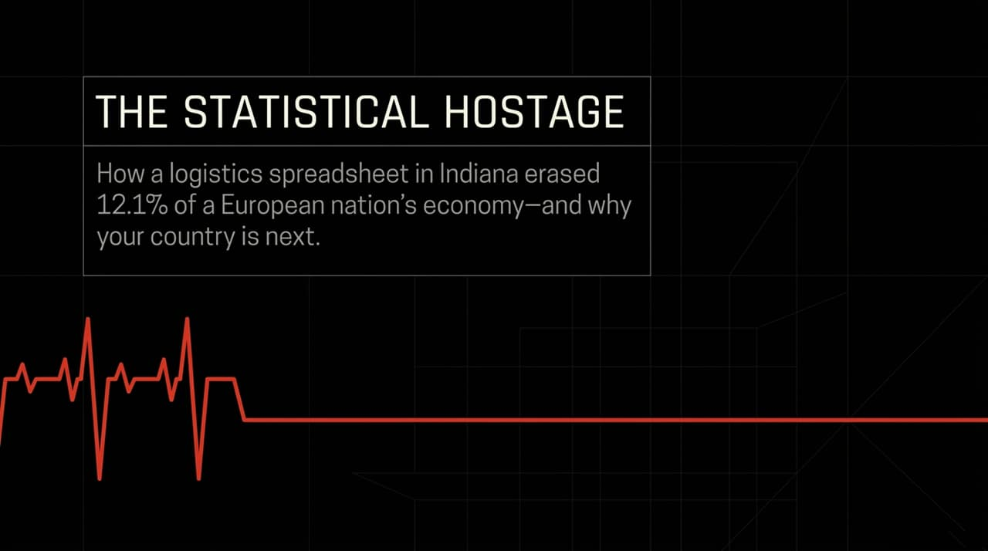
Notes:
The Hook (The Indiana Decision):
Consider this scenario: In early 2026, an inventory logistics manager sitting at a desk in Indianapolis opens up a shipping spreadsheet. They aren't launching a political campaign, protesting tariffs, or attempting to trigger a global crisis. They are simply managing inventory by slowing down a logistics schedule.
The Contrast (The Irish Fallout):
Fast-forward three months: an entire developed nation on the other side of the Atlantic—Ireland—sees its national economy contract by 12.1% in a single quarter. To put that number into perspective, outside of a world war or a global pandemic, a 12.1% quarterly contraction is virtually unheard of in modern developed economies.
No bombs dropped, no banking systems collapsed, and no sovereign defaults occurred. The catalyst was literally a matter of fewer boxes being moved onto container ships.
The Core Thesis:
This case study introduces a critical macroeconomic concept: The Statistical Hostage. We will analyze how foreign corporate decisions can completely hijack a sovereign nation’s measurable prosperity, and why this vulnerability is not isolated to Ireland.
https://www.youtube.com/watch?v=82cmgmHy6_A

Slide 2
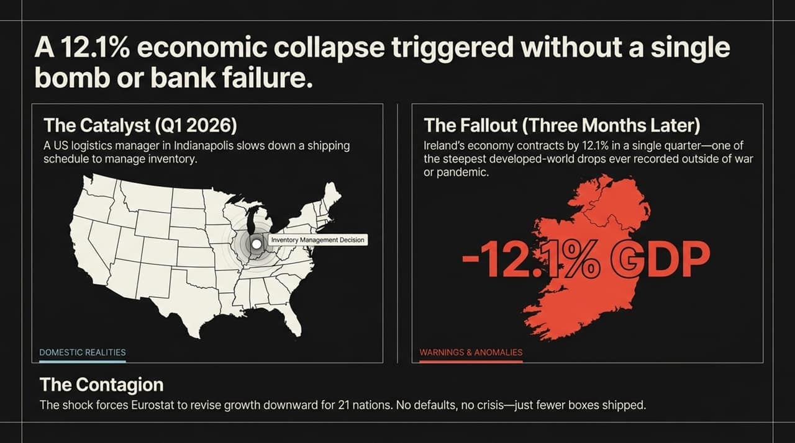
Notes:
The Spillover to Eurostat:
When a 12.1% collapse occurs on a nation's ledger, it doesn't stay neatly contained within its borders. Because Ireland serves as a major hub for European trade and multinational corporate accounting, this single quarterly contraction dragged down the entire Eurozone's economic metrics.
Eurostat was forced to revise economic growth projections downward for 21 member nations. Imagine that: 21 countries had their growth outlooks degraded simply because of logistics adjustments originating out of the US.
Media Narrative vs. Macro Reality:
The mainstream media narrative around this event was quick to dismiss it as a temporary 'statistical blip'—a mere inventory correction following front-loaded pharmaceutical exports.
However, treating a 12.1% quarterly drop as a harmless blip misses the existential structural threat. It demonstrates that a sovereign nation’s headline GDP is effectively decoupled from its domestic reality, leaving national prosperity at the mercy of non-domestic corporate strategies.
Takeaway:
This is a prime example of systemic fragility. Optimization for tax efficiency and corporate convenience creates a system where no defaults or crises are required to trigger a massive economic downturn—just a shift in supply chain timing.

Slide 3
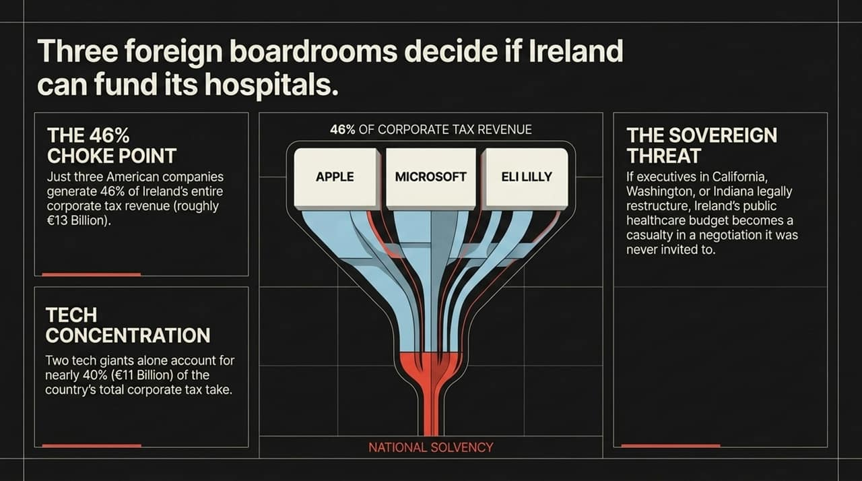
Notes:
Breaking Down the Numbers (46% and €13 Billion):
To understand how Ireland arrived at this point, we need to memorize two key metrics: 46% and €13 Billion.
Just three American multinationals—Apple, Microsoft, and Eli Lilly—generate nearly half (46%) of Ireland’s total corporate tax receipts, providing roughly €13 Billion to state coffers. Furthermore, just two tech giants account for approximately €11 Billion, or nearly 40% of all corporate tax collected.
Sovereign Vulnerability in Foreign Boardrooms:
What does this concentration mean in practice? It means that if executives sitting in boardrooms in Cupertino (California), Redmond (Washington), or Indianapolis (Indiana) make a legal corporate decision to restructure their IP or shift tax jurisdictions, Ireland's fiscal capacity suffers instantly.
Decisions about whether Ireland can fund public healthcare, build housing, or staff public services are ultimately influenced by corporate strategy sessions where Irish policymakers are not even present.
Fiscal Leverage:
When a sovereign nation relies on three balance sheets for nearly half of its core revenue, it forfeits real fiscal sovereignty. The nation becomes reliant on corporate goodwill and tax optimization policies set thousands of miles away.

Slide 4
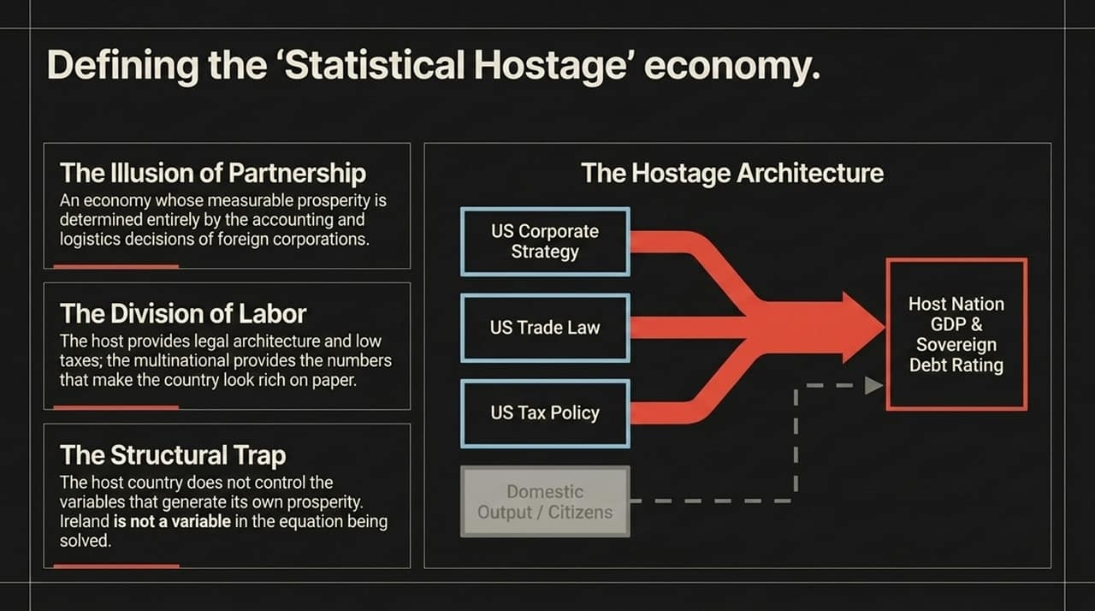
Notes:
Defining the Statistical Hostage Economy:
We define a Statistical Hostage economy as one whose key macro metrics—GDP, tax base, credit ratings, and debt capacity—are dictated by foreign accounting and logistics choices rather than domestic output.
Look at the visual architecture on this slide: On the left, US Corporate Strategy, US Trade Law, and US Tax Policy directly channel into the host nation's primary indicators. Meanwhile, domestic output and local citizens sit on the sidelines, largely disconnected from these headline indicators.
The Division of Labor & Structural Trap:
This structure operates under an asymmetric division of labor: The host country offers favorable tax law, legal architecture, and regulatory access to the EU. In return, foreign multinationals provide the eye-popping statistics that make the host country appear exceptionally wealthy on paper.
The structural trap is that the host government loses control over the variables that drive its reported prosperity. When Apple or Eli Lilly calculates global tax positions, Ireland is not a primary variable in that equation—it is merely the location where ledger entries are processed.
Summary of Fragility:
This is efficiency optimized at the expense of resilience. When foreign entities shift strategic focus, the host nation bears all the downside risk without having any vote in the corporate boardroom.

Slide 5
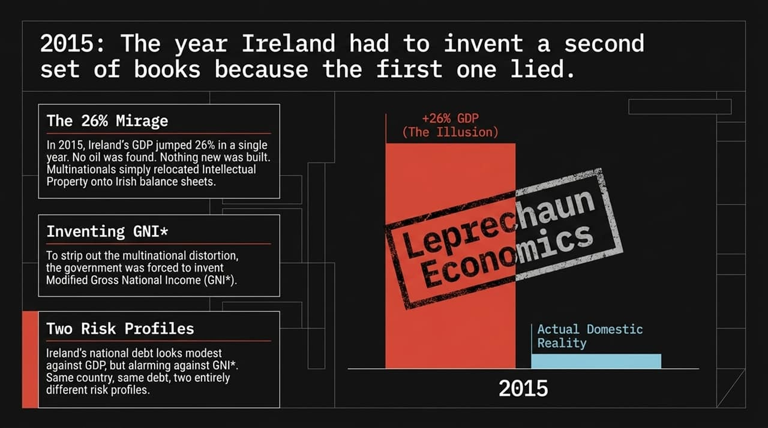
Notes:
The 26% GDP Surge (Leprechaun Economics):
To pinpoint when this structural trap officially closed, we have to look back to 2015. In 2016, Ireland's statistics office reported that 2015 GDP growth hit an astounding +26.3% in a single year.
No massive natural resources were discovered, no major infrastructure popped up overnight, and productivity didn't jump by a quarter. What happened was that major tech multinationals relocated massive Intellectual Property (IP) assets onto Irish corporate balance sheets. Economist Paul Krugman famously labeled this phenomenon 'Leprechaun Economics'.
Inventing a Second Set of Books (GNI):*
The distortion was so severe that Ireland’s official GDP numbers ceased to reflect the actual living standards of its citizens. In response, Ireland took an unprecedented step: it had to invent a second national metric known as Modified Gross National Income, or GNI*.
GNI* strips out multinational IP distortions and aircraft leasing assets to show what the domestic economy is actually doing. Ireland became one of the few nations required to maintain a second set of financial books because its primary economic metrics were compromised by foreign accounting entries.
Two Risk Profiles:
This creates two completely different risk profiles. Measured against GDP, Ireland’s sovereign debt looks comfortably modest. Measured against GNI*, that exact same national debt looks uncomfortably high.

Slide 6
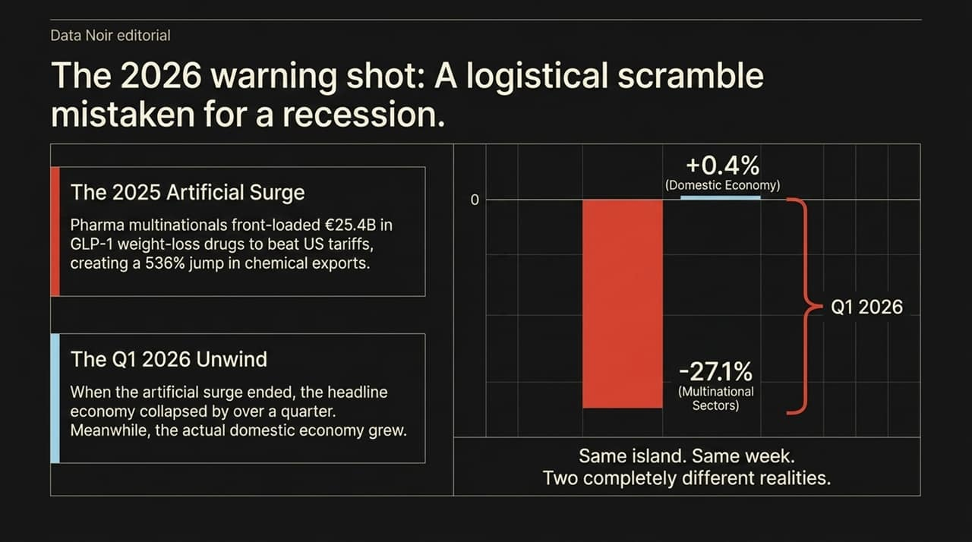
Notes:
The 2025 Front-Loading Surge:
The lead-up to the Q1 2026 drop explains how supply chain decisions create artificial economic spikes. In 2025, pharmaceutical multinationals rushed to export €25.4 Billion worth of GLP-1 weight-loss medications ahead of threatened US trade tariffs.
This resulted in a staggering 536% surge in chemical exports in early 2025. That wasn't organic growth—it was a frantic effort to move product into American warehouses before trade policy shifted.
The Q1 2026 Unwind & Divergence:
When that artificial front-loading ended in early 2026, the correction hit immediately. Multinational sectors in Ireland contracted by -27.1% in Q1 2026.
At the exact same time, Ireland's domestic economy—where citizens work, shop, and operate local businesses—actually grew by +0.4%.
Two Realities on One Island:
Look at the chart on Slide 6: Same island, same week, two completely separate realities. The challenge is that international credit rating agencies and global bond markets primarily evaluate the headline numbers, exposing Ireland to volatility based on corporate inventory movements rather than domestic performance.

Slide 7
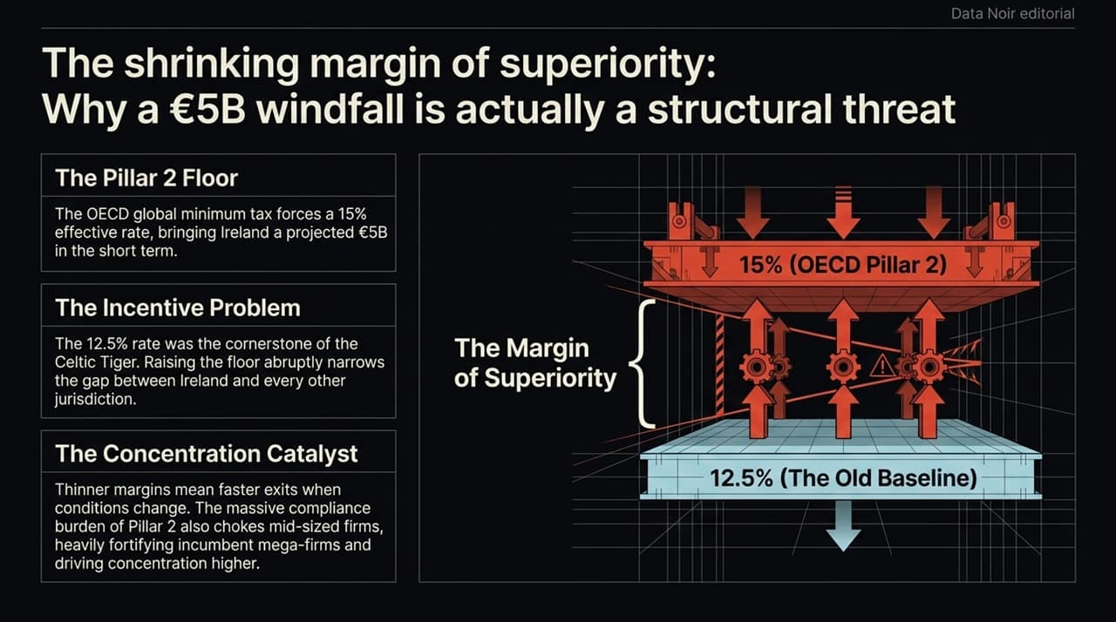
Notes:
OECD Pillar 2 Implementation:
For decades, Ireland’s 12.5% corporate tax rate was the bedrock of its Foreign Direct Investment (FDI) strategy. Under the OECD Pillar 2 global tax framework, a 15% effective minimum rate is being enforced.
In the short run, this rate increase brings an extra projected €5 Billion per year into state revenues. However, viewing this purely as a financial win ignores the underlying incentive structure.
Narrowing the Advantage Gap:
Moving from 12.5% to 15% significantly reduces Ireland's tax rate advantage relative to other markets. As that gap shrinks, corporate questions shift from 'Why would we leave?' to 'Why should we stay?'
While Ireland retains strong structural advantages—such as an English-speaking workforce, EU market access, and deep pharma/tech clusters—thinner tax margins increase corporate sensitivity to policy changes.
Concentration Catalyst:
Additionally, Pillar 2 imposes complex regulatory compliance demands. While global tech giants can easily absorb these administrative costs, mid-sized international firms may find them restrictive. This dynamic further locks in market dominance for the largest players and increases revenue concentration.

Slide 8
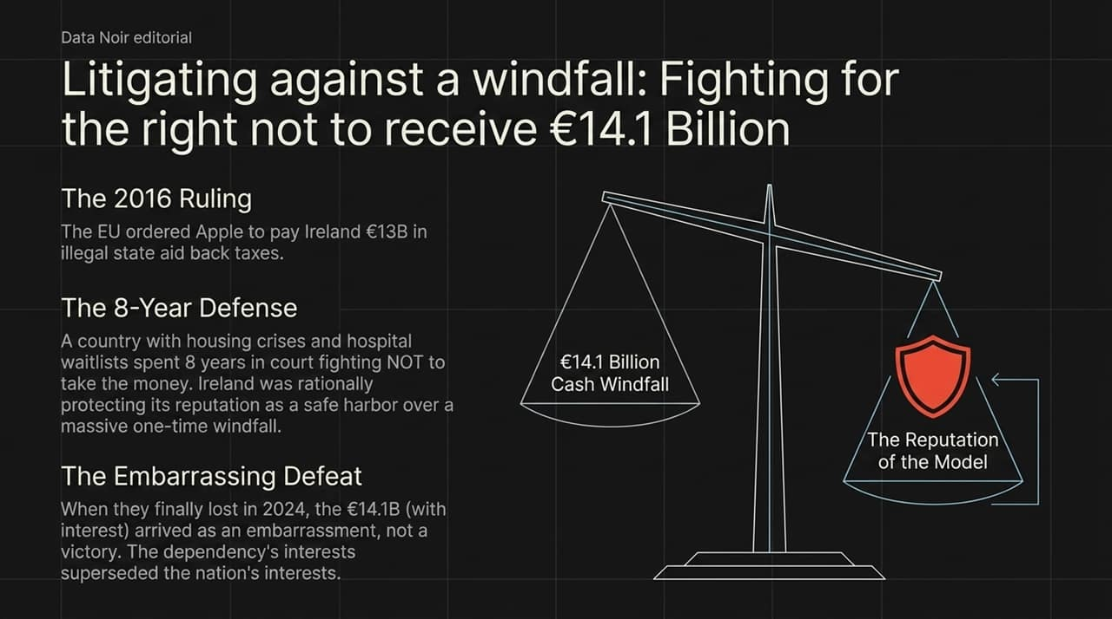
Notes:
The 2016 EU Ruling & Ireland’s Appeal:
In 2016, the European Commission ruled that Ireland had granted illegal state tax aid to Apple, ordering the recovery of approximately €13 Billion in back taxes.
Instead of collecting the funds, the Irish government spent eight years in European courts fighting not to accept the money.
Rational Behavior Within a Hostage Framework:
Why would a nation dealing with domestic housing shortages and healthcare demands spend public resources to decline €13 Billion?
Within the logic of a multinational-dependent economy, this decision was calculated to protect national strategy. A one-off cash payment of €13 Billion is far less valuable long-term than maintaining a global reputation as a predictable tax jurisdiction for foreign capital.
The 2024 Outcome:
When the European Court of Justice finally rejected Ireland’s appeal in 2024, forcing the transfer of €14.1 Billion (including interest) into escrow, the payout was viewed politically as an uncomfortable complication rather than a fiscal win.
It serves as a stark illustration of how institutional priorities align with foreign investment models when national strategy becomes tightly coupled with multinational interests.

Slide 9
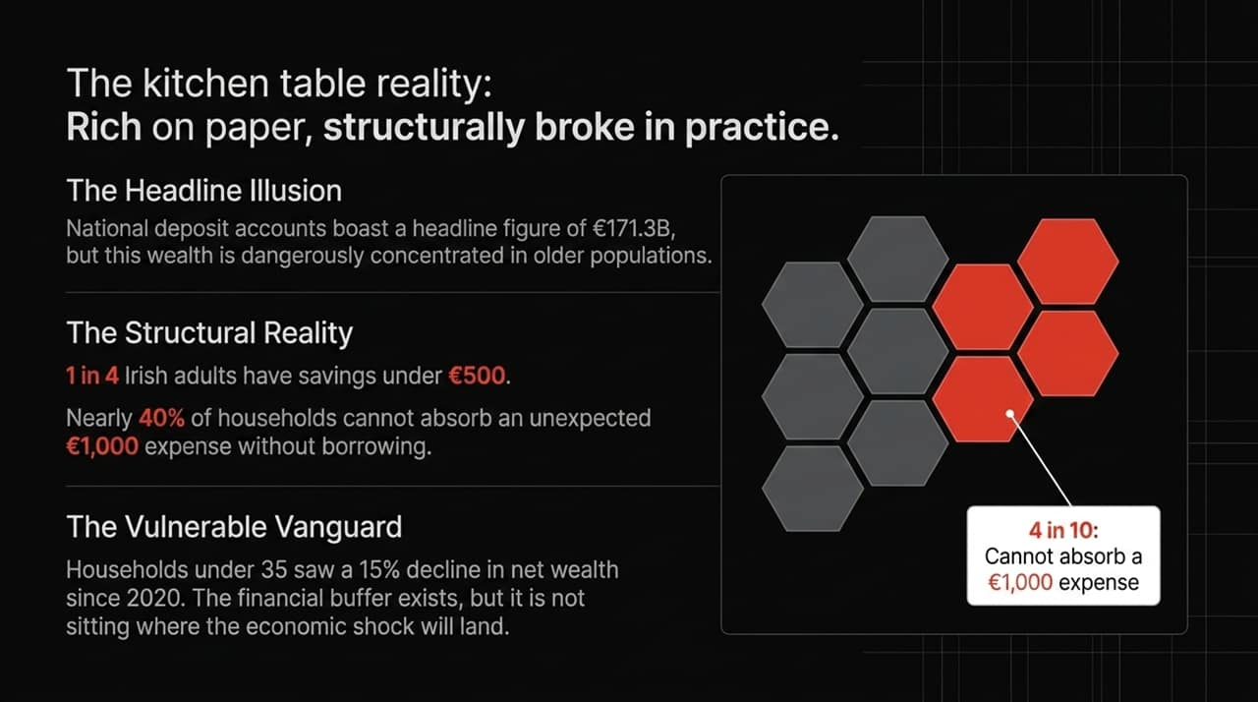
Notes:
Macro Wealth vs. Micro Vulnerability:
Moving from sovereign balance sheets to individual households reveals a sharp divide between statistical indicators and real-world resilience.
Headline reports highlight that Irish bank accounts hold €171.3 Billion in total deposits. Yet, much like GDP metrics, this total figure conceals significant underlying distribution gaps.
The Household Data Breakdown:
A closer look at private savings reveals clear structural pressures:
1 in 4 adults has less than €500 in liquid savings.
Nearly 40% (4 in 10) of households cannot absorb an unexpected €1,000 expense without relying on debt.
Households under 35 have recorded a 15% decline in median net wealth since 2020.
The Mismatched Cushion:
This exposes a core vulnerability: household financial buffers are concentrated in older demographics, while younger working populations face higher exposure to economic adjustments in volatile sectors.
When top-line national wealth indicators obscure limited household liquidity, broad economic shocks quickly translate into immediate consumer stress.

Slide 10
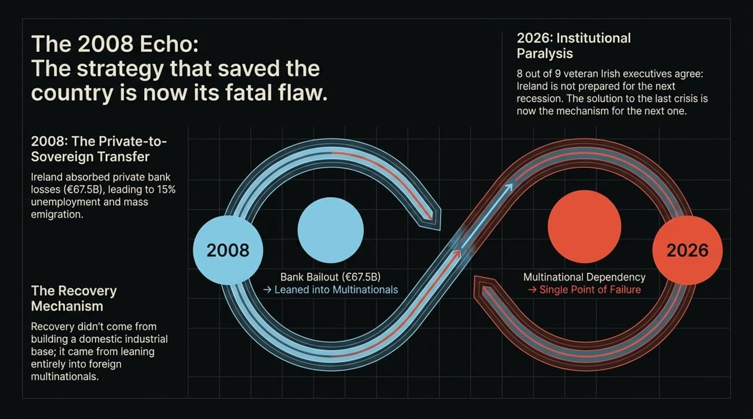
Notes:
The 2008 Pivot:
To understand current policy choices, we have to look back at how Ireland responded to the 2008 global financial crisis.
In 2008, the state absorbed private banking liabilities totaling €67.5 Billion, leading to severe austerity, 15% unemployment, and rising emigration rates. The path to recovery was driven by doubling down on foreign multinational investment rather than building a diversified domestic industrial sector.
The Institutional Reflex:
That recovery model proved effective for stabilization, but over time it grew into a single point of failure. The policy approach that resolved the previous downturn developed into a key vulnerability for the next one.
A survey of senior Irish executives highlighted this institutional dynamic: 8 out of 9 veteran business leaders agreed that Ireland is insufficiently prepared for a severe structural downturn.
The Trap of Past Success:
Organizations and nations often default to strategies that resolved past crises. When structural conditions shift, relying strictly on legacy playbooks leaves little room to address emerging challenges.

Slide 11
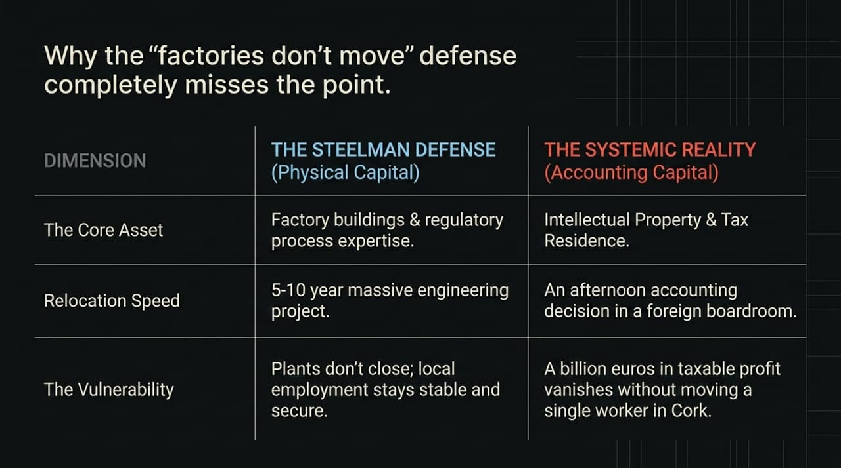
Notes:
The Steelman Defense (Physical Capital):
Let's rigorously examine the strongest counterargument to this thesis—the Steelman Defense.
Industry observers point out that physical pharmaceutical facilities and tech campuses are highly capital-intensive assets. Relocating a specialized bio-pharma plant requires regulatory approvals, specialized infrastructure, and multi-year timelines. In short, factories do not pack up and move in a single quarter.
The Systemic Reality (Accounting Capital):
While physical plants remain stationary, that view overlooks the role of mobile financial assets.
The primary vulnerability isn't the physical relocation of manufacturing equipment—it's the reassignment of Intellectual Property (IP), corporate tax residency, and profit allocations.
Physical Capital: Moving a factory takes 5 to 10 years.
Accounting Capital: Reallocating billions in taxable IP profit can occur instantly via board resolution.
The Disconnection:
A plant can maintain operations in Cork while corporate IP revenue is shifted elsewhere. Employment figures may hold steady, but the state tax base tied to IP transactions can contract abruptly. Physical stability does not protect against accounting volatility.

Slide 12
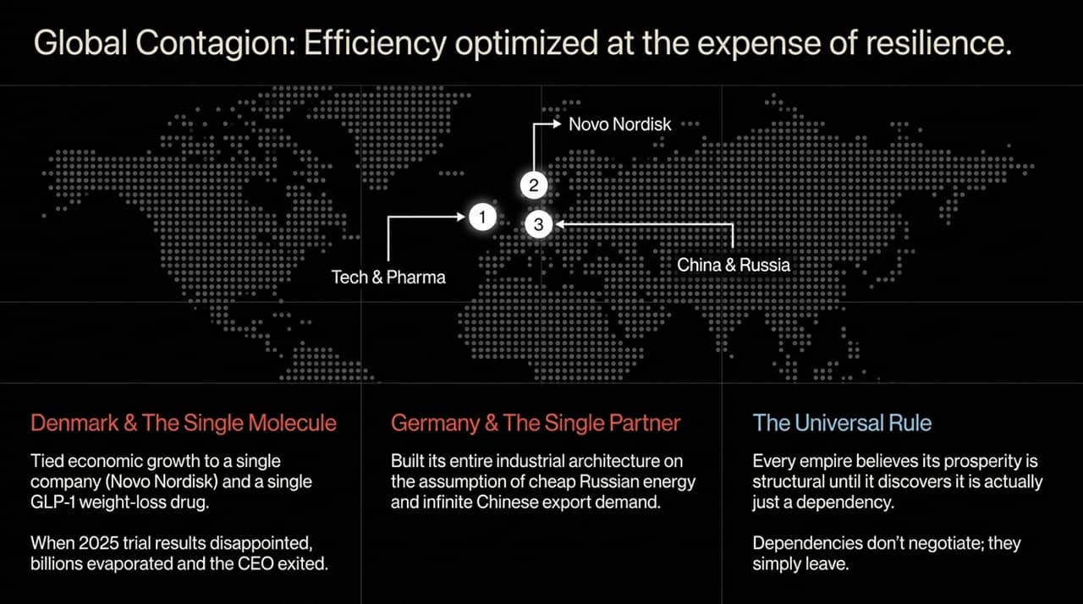
Notes:
Denmark & The Single Molecule Risk:
Concentration risk is not isolated to Ireland; it appears across multiple economic models. Consider Denmark, where recent domestic growth became closely tied to Novo Nordisk and demand for GLP-1 treatments.
When Novo Nordisk's market capitalization expanded, it drove headline Danish GDP metrics. However, when clinical trial updates disappointed and market competition intensified, substantial equity value adjusted quickly. Stripping out that single pharma sector left broader domestic growth relatively flat.
Germany & Single Partner Dependency:
Similarly, Germany built its industrial framework around predictable inputs: low-cost Russian energy imports and steady manufacturing exports to China.
When geopolitical conditions disrupted energy supply chains and shifted external market demand, Germany faced immediate headwinds across its core manufacturing model.
The Universal Rule:
The broader takeaway across these examples is clear: relying heavily on a single product category, specialized tax structure, or key trading partner creates structural vulnerability when external conditions adjust.

Slide 13
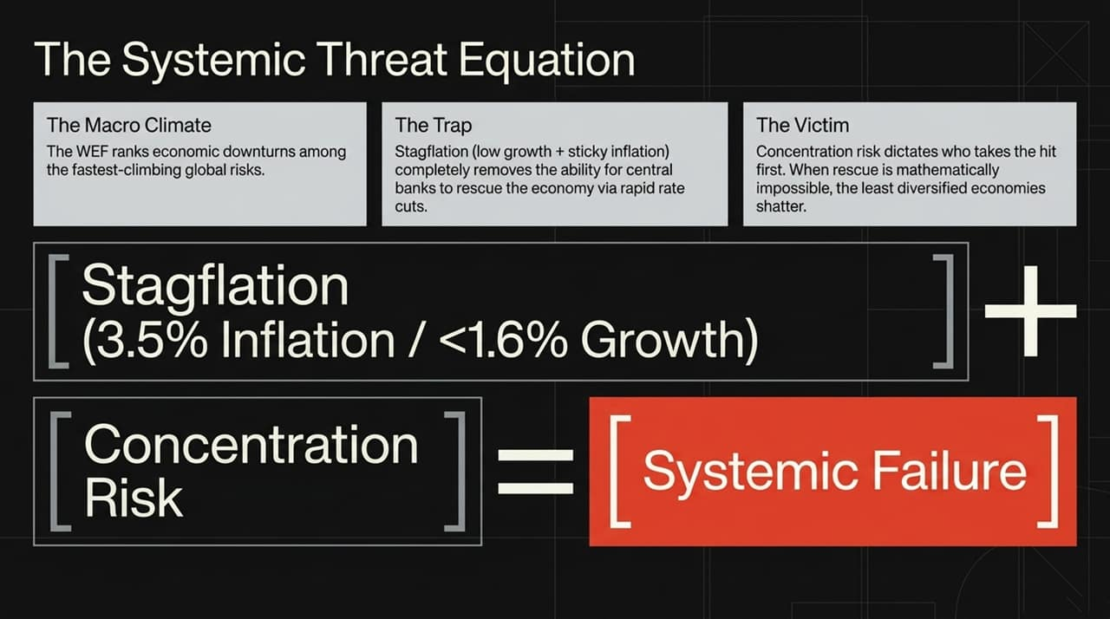
Notes:
Global Macro Environment (WEF Outlook):
The World Economic Forum ranks persistent economic downturns among the fastest-growing risks facing global markets over a multi-year horizon.
With major developed economies seeing modest baseline growth alongside sticky inflation dynamics, central banks face narrower policy flexibility. Rapid rate cuts become harder to implement without triggering price pressures.
The Math of Concentration Risk:
This leads to our primary analytical framework:
$$\text{[}\text{Stagflation}\text{ (3.5\% }\text{Inflation}\text{ / <1.6\% }\text{Growth}\text{)]}+\text{[}\text{Concentration} \text{Risk}\text{]}=\text{[}\text{Systemic} \text{Failure}\text{]}$$
When global growth moderates, highly diversified economies can absorb shocks across varied sectors. Concentrated economic models, by contrast, experience amplified impacts when their primary growth driver adjusts.
Takeaway:
Efficiency gains without structural diversification increase exposure to sudden market pivots. When monetary policy responses are constrained by inflation, concentrated economic models face heightened vulnerability.

Slide 14
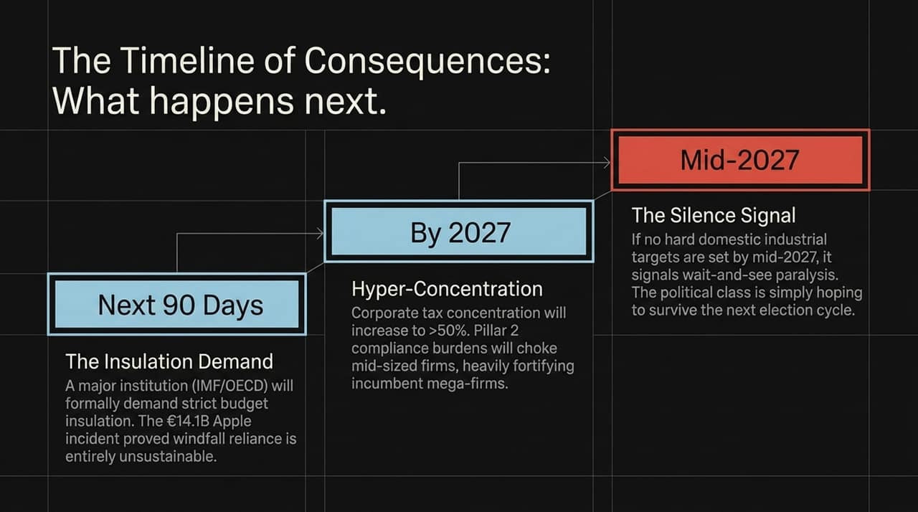
Notes:
Next 90 Days (Institutional Insulation Demand):
Looking ahead, we project three distinct operational milestones.
Within the next 90 days, major multilateral bodies—such as the IMF, OECD, or domestic fiscal watchdogs—are expected to issue recommendations for stricter budget protections to ring-fence sovereign spending from corporate revenue volatility. The €14.1 Billion Apple case demonstrated the risks of relying on volatile, one-off receipts for ongoing fiscal planning.
By 2027 (Accelerating Concentration):
By 2027, top-tier corporate tax concentration is projected to rise above 50%.
As Pillar 2 compliance requirements add administrative complexity, larger market incumbents are better positioned to absorb these costs than smaller firms. This structural cost advantage risks further concentrating revenue among a small group of market leaders.
Mid-2027 (The Silence Signal):
By mid-2027, observe state policy actions closely. If clear domestic diversification benchmarks are not established, it signals policy inertia. Relying on short-term market stability rather than implementing structural reforms leaves underlying economic models exposed.

Slide 15
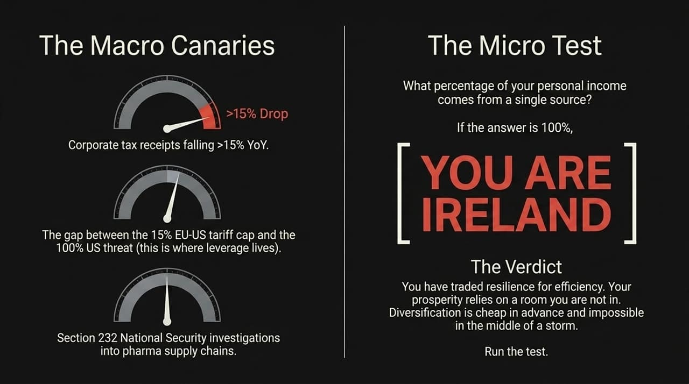
Notes:
Macro Canaries to Track:
To track these developments, monitor three practical indicators:
Monthly Tax Receipts: Track national corporate tax figures. Year-over-year drops exceeding 15% signal real-time revenue adjustments.
Tariff Policy Gaps: Monitor trade policy developments between major economic blocs. Policy gaps create strategic leverage that directly impacts concentrated supply chains.
Regulatory Trade Reviews: Watch ongoing trade and national security reviews into critical supply chains.
The Micro Test: YOU ARE IRELAND:
Apply this analytical framework at the individual level: Ask yourself, 'What percentage of personal or organizational revenue depends on a single source?'
If that figure is 100%, you face a similar structural vulnerability as Ireland. High efficiency achieved without revenue diversification leaves operations exposed when primary revenue streams shift.
Conclusion & Core Lesson:
Diversification options are straightforward to implement before market disruptions occur, but difficult to put in place during an active downturn. Evaluating structural concentration early remains the most effective defense.

Slide 16
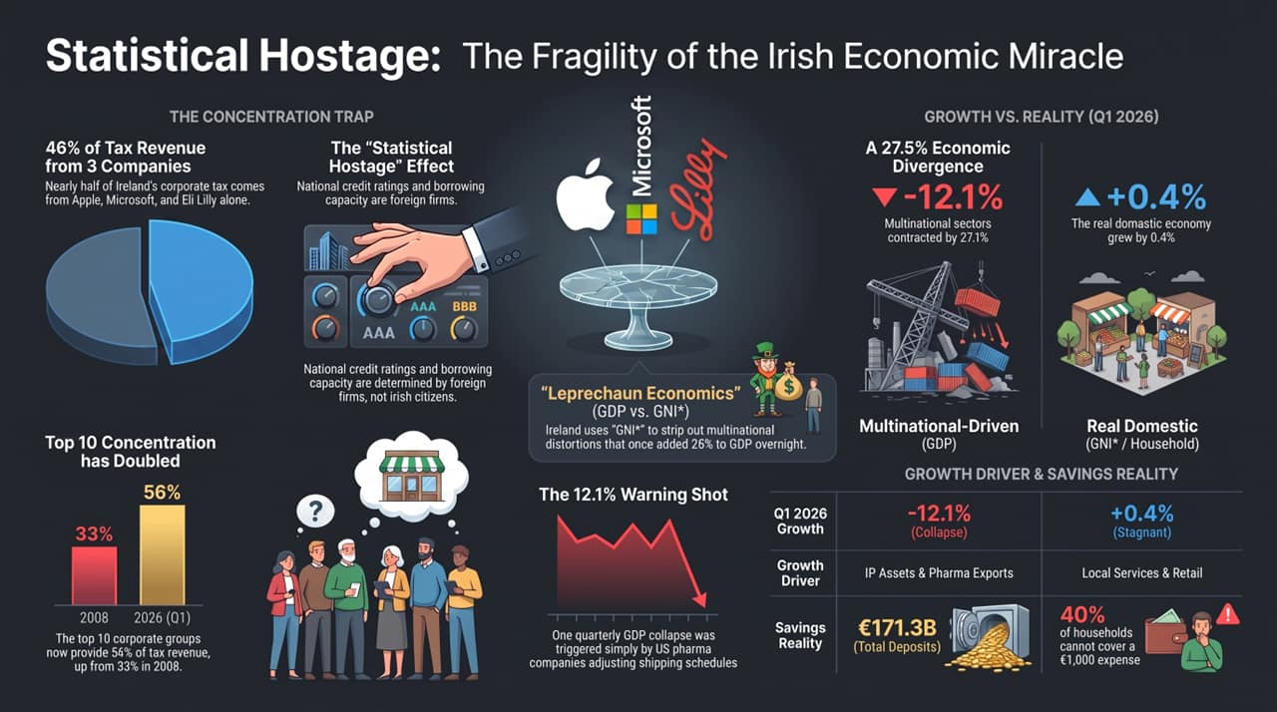
Notes:
Pillar 1: The Concentration Trap:
To wrap up our analysis, this summary dashboard synthesizes the structural realities of a Statistical Hostage economy.
First, consider Tax Concentration: 46% of Ireland's total corporate tax receipts depend on just three firms (Apple, Microsoft, Eli Lilly). Furthermore, revenue concentration among the top 10 corporate groups has expanded from 33% in 2008 to 56% by 2026. Credit profiles and sovereign ratings remain tightly coupled to corporate decisions made far outside national borders.
Pillar 2: Growth vs. Reality (Q1 2026 Divergence):
Second, review the Growth vs. Reality metrics from Q1 2026: Headline GDP recorded a steep 12.1% contraction, driven by a 27.1% decline in foreign-dominated sectors, while the domestic economy posted modest 0.4% growth.
This divergence highlights why traditional GDP figures can obscure underlying domestic conditions, requiring specialized metrics like GNI* to track real economic performance.
Pillar 3: Savings Reality & Final Takeaway:
Finally, look at Household Reserves: Despite €171.3 Billion in aggregate bank deposits, 40% of households lack liquid reserves to cover an unexpected €1,000 expense.
The primary lesson of the Statistical Hostage model is clear: economic resilience requires structural diversification. Relying heavily on concentrated revenue sources—whether at the sovereign, corporate, or individual level—leaves long-term outcomes exposed to external shocks. Thank you.

